Slide 1

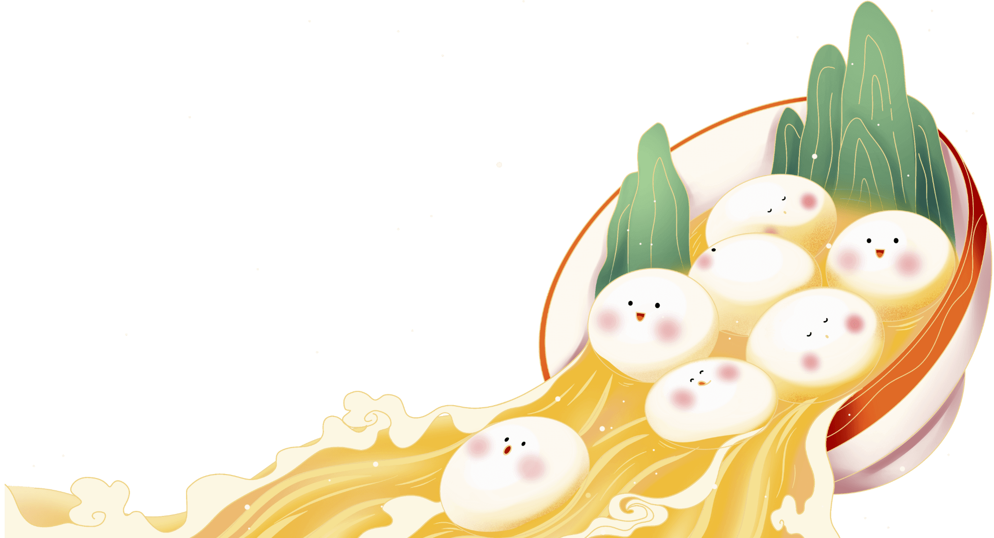

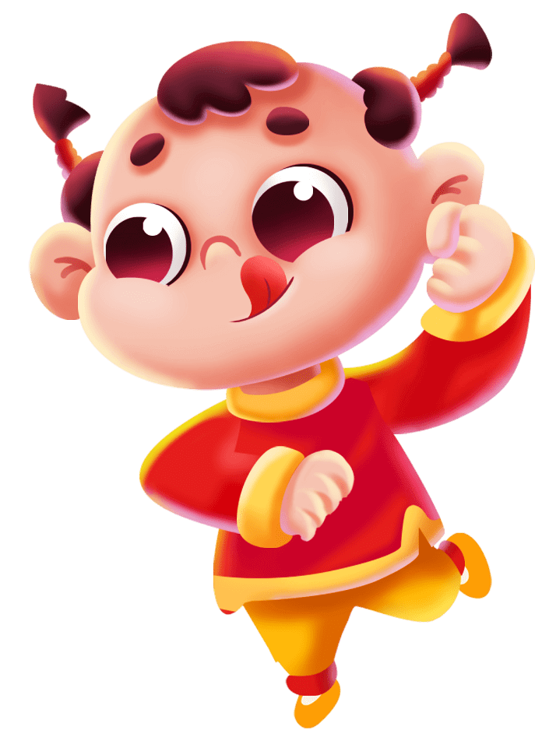

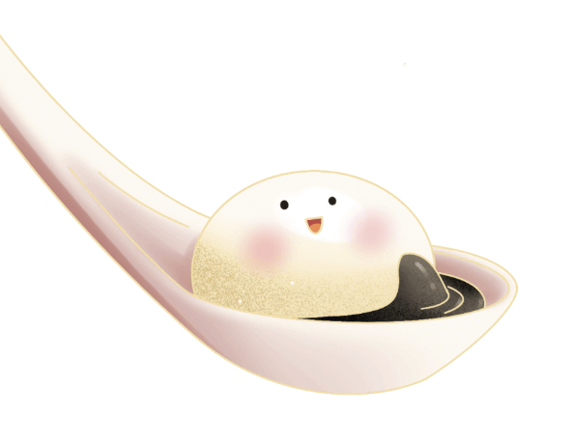
正
月
十
五
团
团
圆
圆
元宵节英文介绍主题班会
English introduction to the Lantern Festival

Slide 2
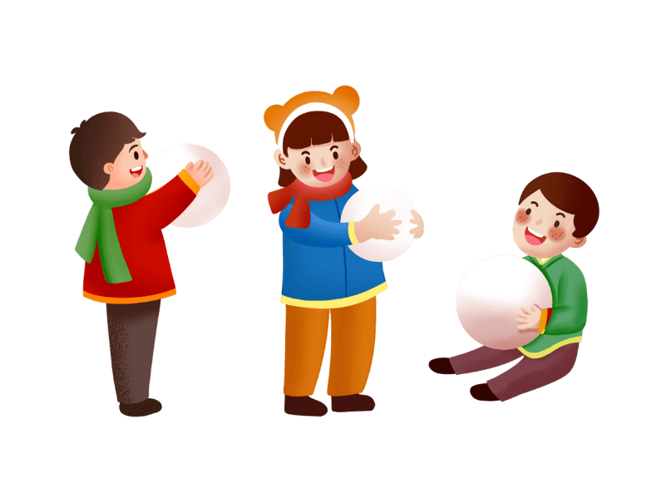
https://www.ypppt.com/
一
元宵节介绍
目录
二
元宵节的习俗
三
元宵节相关词汇
四
元宵节英语猜灯谜

Slide 3

第
一
部
分
元宵节介绍

Slide 4
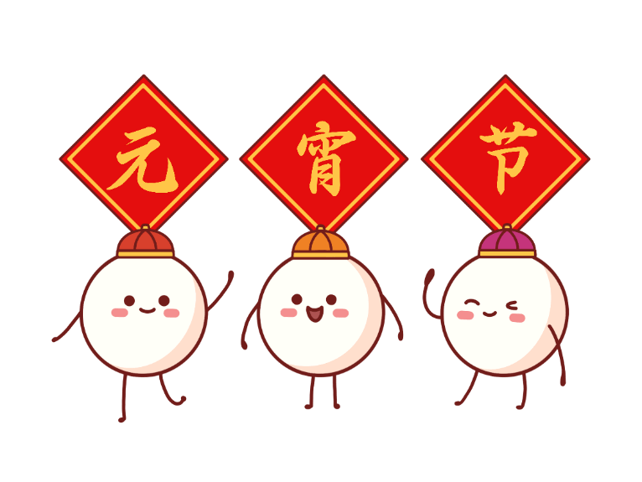
元宵节介绍
The Lantern Festival is cele/pated everywhere on January 15th of the lunar calendar, right after the Spring Festival. Traditionally, the Lantern Festival is a part of the Spring Festival.
每年农历的一月十五日是中国人的元宵节，它正好在春节之后。传统意义上元宵节也是春节活动的一部分。这天是农历新年里第一个月圆的日子。

Slide 5
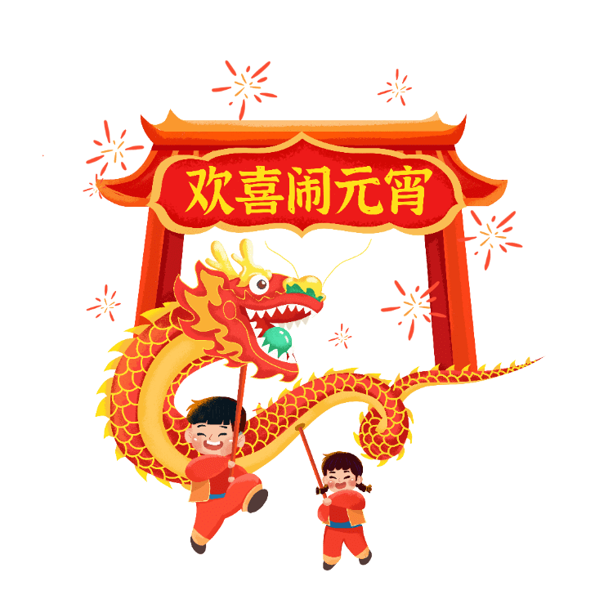
元宵节介绍
This day is always the first full moon in the lunar New Year.
中国各地张灯结彩，家家户户歌舞游乐，人们做元宵、放烟火。

Slide 6
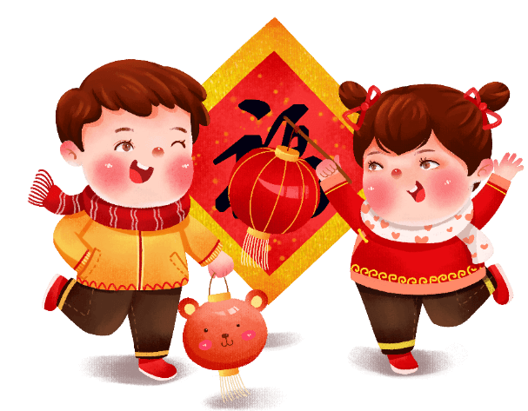
元宵节介绍
Across China, people cele/pate by hanging up lanterns and festoons, attending dancing and singing performances, making “Yuan Xiao"or sweet rice dumplings and lighting fireworks.
这也是庆祝春节的延续。

Slide 7
元宵节介绍
The lanterns sometimes come in a series about certain folklore, holiday customs, or lucky mascots.The Lantern Festival is also a romantic holiday. ln feudal society, young girls were not allowed to go out freely.
元宵节也是—个浪漫的节日。在封建社会时，年轻女孩不允许出外自由活动。但在元宵节晚上，她们却可以结伴出游观赏花灯。

Slide 8
第
二
部
分
元宵节的习俗

Slide 9
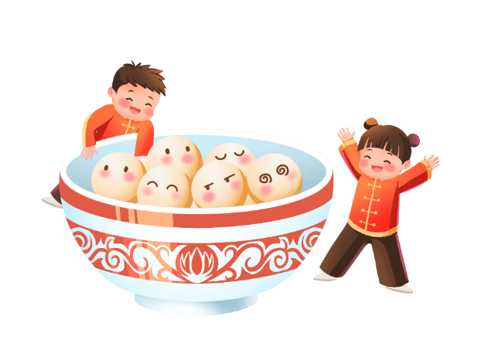
Eating Yuanxiao 吃元宵
Yuanxiao is the special food for the Lantern Festival. lt is believed that Yuanxiao is named after a palace maid, Yuanxiao, of Emperor wu Di of the Han Dynasty. Yuanxiao is a kind of sweet dumpling, which is made with sticky rice flour filled with sweet stuffing . And the Festival is named after the famous dumpling. It is very easy to cook - simply dump them in a pot of boiling water for a few minutes - and eaten as a dessert.
元宵是元宵节的特色食品。据说，元宵是因汉武帝时期的一位名叫元宵的宫女而得名。元宵是一种带馅儿的甜食，是由糯米粉加上甜的馅料制成。元宵节就是因此食品得名。元宵的烹制方法非常简单，将元宵倒入装满沸水的锅中煮几分钟就可以了。
节日PPT模板 http://www.ypppt.com/jieri/

Slide 10
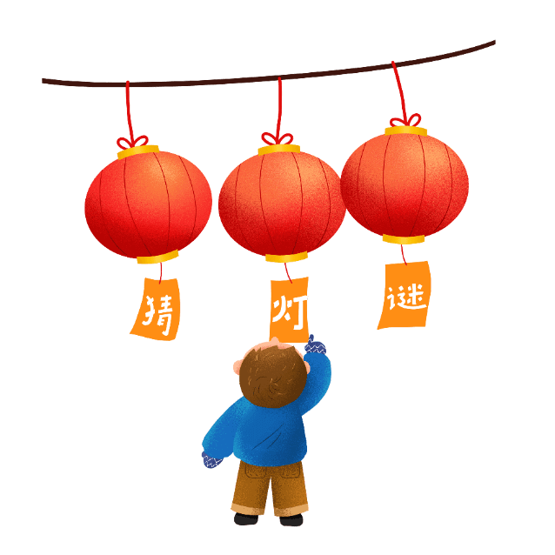
Guessing lantern riddles猜灯谜
Guessing lantern riddles“ is an essential part of the Festival . Lantern owners write riddles on a piece of paper and post them on the lanterns. If visitors have solutions to the riddles, they can pull the paper out and go to the lantern owners to check their answer. If they are right, they will get a little gift . The activity emerged during people's enjoyment of lanterns in the Song Dynasty(960-1279).As riddle guessing is interesting and full of wisdom, it has become popular among all social strata.
猜灯谜也是元宵节活动的一个基本组成部分。灯笼的所有者将谜语写在一张纸条上，然后将纸条展示在灯笼上。如果赏灯者猜出谜语，就将纸条取出，然后找灯笼所有者确认答案。打对的话，他们就可以领取一份小礼品。这个活动起源于宋朝(960——1279)。猜灯谜活动极富情趣和智慧，因此在全社会广受欢迎。"

Slide 11

Watch fireworks看烟花
ln the daytime of the Festival, performances such as a dragon lantern dance, a lion dance, a land boat dance, a yangge dance, walking on stilts and beating drums while dancing will be staged. On the night, except for magnificent lanterns, fireworks form a beautiful scene. Most families spare some fireworks from the Spring Festival and let them off in the Lantern Festival. Some local governments will even organize a fireworks party . on the night when the first full moon enters the New Year, people become really intoxicated by the imposing fireworks and /pight moon in the sky.
元宵节的白天会有舞龙舞狮、划旱船、扭秧歌、踩高跷。而在晚上，除了各种大型灯会，灿烂的焰火也是一幅美丽的画卷。很多家庭在春节时会留下一部分烟花等着元宵节放。有的地方政府甚至会组织焰火晚会。当新年的第一轮圆月升上夜空时，人们都会因燃放的烟火和空中的明月而兴奋。

Slide 12
第
三
部
分
元宵节相关词汇

Slide 13
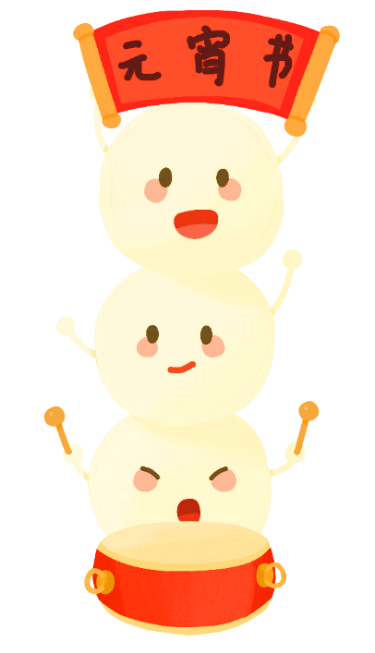
正月十五
元宵
The 15th day of the 1st lunar month
Yuanxiao / the rice glue ball / sweet dumplings
元宵节
汤圆
the Lantern Festival / Festival of Lanterns
glutinous rice balls / glue pudding / sweet dumplings
猜灯谜
舞龙/舞狮
lions/dragons dancing
guess lantern riddles
Notes:
https://www.ypppt.com/

Slide 14
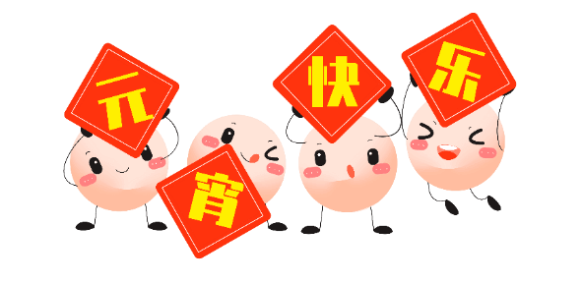
对对联
赏花灯
灯花
play couplets game
enjoy beautiful lanterns
snuff
灯会
耍龙灯
踩高跷
exhibit of lanterns
dragon lantern dancing
walking on stilts

Slide 15
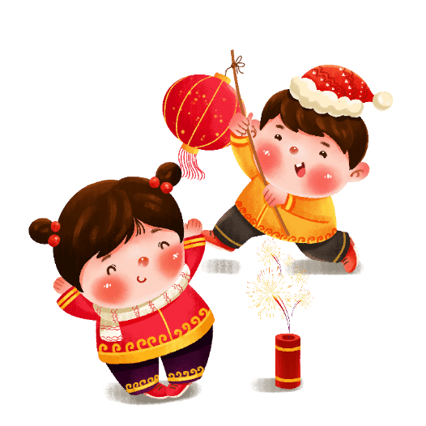
焰火大会
戏曲
fireworks party
traditional opera
杂耍
腰鼓舞
variety show/vaudeville
drum dance
元宵庙会
彩灯庙会
Lantern Festival's temple fair
colored lanterns' temple fair

Slide 16
第
四
部
分
元宵节英语猜灯谜

Slide 17

元宵节英语猜灯谜
1.what man cannot live in a house?
什么人不能住在房子里?
Answer:
snowman(雪人)

Slide 18

元宵节英语猜灯谜
2.What never asks questions but gets a lot of answers?
什么东西永远不问问题但是却能得到很多答案?
Answer:
dictionary(字典)

Slide 19

元宵节英语猜灯谜
3.lt has a head , but no neck.lt has a body,but no warmth.NO feet,but can travel?
它有头，但没有脖子，有身体，但不温暖，没有脚，却能旅行。
Answer:
a car(汽车)

Slide 20
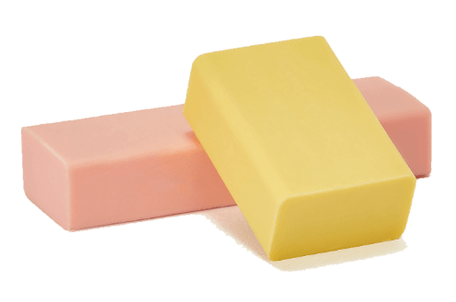
元宵节英语猜灯谜
4.What s full of holes but still holds water?
什么东西浑身是洞，却能装水?
Answer:
a sponge(海绵)

Slide 21
元宵节英语猜灯谜
5.Which is faster, hot or cold?
hot
热和冷哪个速度更快?
Answer:
Hot . You can catch a cold.热更快，因为你能抓住冷

Slide 22

元宵节英语猜灯谜
6.What is it that everybody does at the same time?
所有人同时在做的事情是什么?
Answer:
grow older(长大)

Slide 23
元宵节英语猜灯谜
3月
7.What month do soldiers hate?
士兵们最恨几月份?
Answer:
March三月(注:march也有行军的意思)

Slide 24

元宵节英语猜灯谜
8.What kind of dog doesn t bite or bark?
什么狗不咬人不吠叫?
Answer:
Hot dog grow older(热狗)

Slide 25
正
月
十
五
团
团
圆
圆
元宵节英文介绍主题班会
English introduction to the Lantern Festival

Slide 26
更多精品PPT资源尽在—优品PPT！
www.ypppt.com
PPT模板下载：www.ypppt.com/moban/ 节日PPT模板：www.ypppt.com/jieri/
PPT背景图片：www.ypppt.com/beijing/ PPT图表下载：www.ypppt.com/tubiao/
PPT素材下载： www.ypppt.com/sucai/ PPT教程下载：www.ypppt.com/jiaocheng/
字体下载：www.ypppt.com/ziti/ 绘本故事PPT：www.ypppt.com/gushi/
PPT课件：www.ypppt.com/kejian/
Notes:
模板来自于 优品PPT https://www.ypppt.com/

