Slide 1







5.10
母亲节英文介绍
蓝色温暖母亲节通用PPT模板

Slide 2
https://www.ypppt.com/
Mother's Day
Mother's Day is a celebration honoring the mother of the family, as well as motherhood, maternal bonds, and the influence of mothers in society.
母亲节是一个庆祝家庭的母亲，母亲的身份，母系的纽带，以及母亲对社会的影响。

Slide 3

Contents 目录
01
History of Mother′s Day
母亲节的来源
02
Famous phrase
名言名句
03
Mother‘s Day blessing
母亲节祝福

Slide 4
Part 1
History of Mother′s Day
母亲节的来源

Slide 5


History of Mother′s Day
母亲节的来源
The tradition of Mother's Day originated from the worship of the goddess in ancient Greece. In the middle of the 17th century, Mother's Day spread to the UK.
母亲节的传统起源于古希腊对女神的崇拜。17世纪中叶，母亲节流传到英国。

Slide 6

History of Mother′s Day
母亲节的来源
Mrs. Jarvis's mother and daughter commemorated and praised her mother for her life. In 1914, the US Congress officially established the second Sunday of May each year as Mother's Day.
美国贾维斯夫人母女对纪念和赞扬母亲终生不懈，1914年美国国会正式确立每年5月的第二个星期日为母亲节。

Slide 7
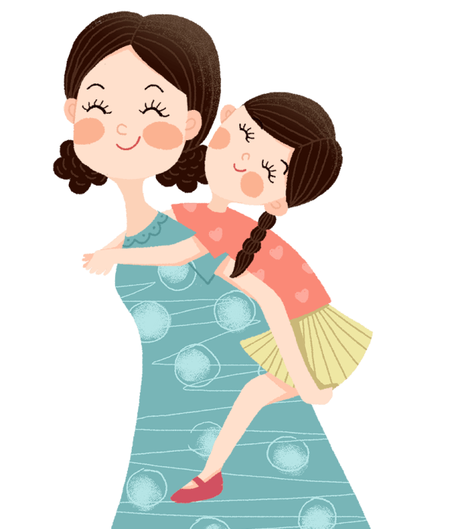
History of Mother′s Day
母亲节的来源
President Wilson took the lead in flying his flag festival to express his love and respect for all mothers of the United States of America.
威尔逊总统率先自己的住宅悬挂国旗节以表达对美利坚合众国全体母亲的热爱和尊敬。

Slide 8

History of Mother′s Day
母亲节的来源
After that, it was supported by many countries in the world, and became an international Mother's Day on May 11 each year.
之后，得到世界众多国家支持，每年的5月11日成为国际性的母亲节。
节日PPT模板 http://www.ypppt.com/jieri/

Slide 9

History of Mother′s Day
母亲节的来源
n the United States, Mother's Day is the second Sunday in May. Denmark, Finland, Italy, Turkey, Australia, and Belgium celebrate Mother's Day on the same day as in the U.S.
在美国，母亲节为五月的第二个星期日，丹麦、芬兰、意大利、土耳其、澳大利亚，以及比利时同美国一样。

Slide 10

History of Mother′s Day
母亲节的来源
On this day mothers often receive gifts. Overseas, the carnation flower is regarded as dedicated to his mother. In China, mother lily flower flower, also known as Wang Youcao.
母亲们在这一天通常会收到礼物。
在国外，康乃馨被视为献给母亲的花。
而我国的母亲花是萱草花，又叫忘忧草
Notes:
https://www.ypppt.com/

Slide 11
Part 2
Famous phrase
名言名句

Slide 12

Famous phrase
名言名句
世界上的一切光荣和骄傲,都来自母亲。(高尔基)
All the world of glory and pride from his mother. (Golgi)
母爱是一种巨大的火焰。(罗曼.罗兰)
Motherly love is a huge flame. (Romain Rolland)
世界上有一种最美丽的声音，那便是母亲的呼唤。(但丁)
The world there is a most beautiful voice, and that is the call of the mother. (Dante)

Slide 13
Famous phrase
名言名句
慈母的胳膊是慈爱构成的,孩子睡在里面怎能不甜? (雨果)
Mother is the charity arm of the composition, the children could not sleep in it sweet?(Hugo)
人的嘴唇所能发出的最甜美的字眼，就是母亲，最美好的呼唤，就是“妈妈”。(纪伯伦)
Person's lips can be issued by the sweet words, that is, mother, best call is the "mother." (Kahlil Gibran)
01
02
母爱是世间最伟大的力量。(米尔)
Maternal love is the greatest force in the world. (Mir)
03
04
成功的时候，谁都是朋友。但只有母亲一一一她是 失败时的伴侣。(郑振铎)
When successful, who are friends. But only his mother --- she was a partner at the time

Slide 14
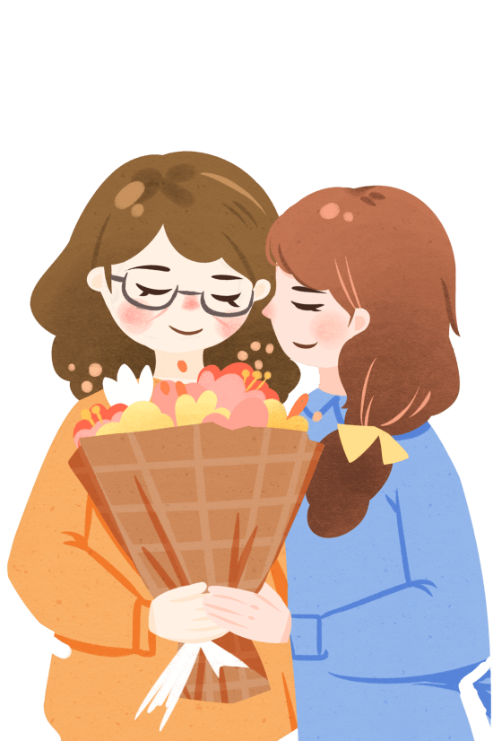
Famous phrase
名言名句
母爱是多么强烈、自私、狂热地占据我们整个心灵的感情。(邓肯)
Motherly love is how strong, selfish and feverishly occupied mind the feelings of the Whole. (Duncan)
世界上的一切光荣和骄傲，都来自母亲。(高尔基)
All the world of glory and pride from his mother. (Golgi)
人生最美的东西之一就是母爱，这是无私的爱,道德与之相形见拙。(日本)
One of the most beautiful things in life is love, which is selfless love, morality pales beside them. (Japan)

Slide 15
Part 3
Mother‘s Day blessing
母亲节祝福

Slide 16
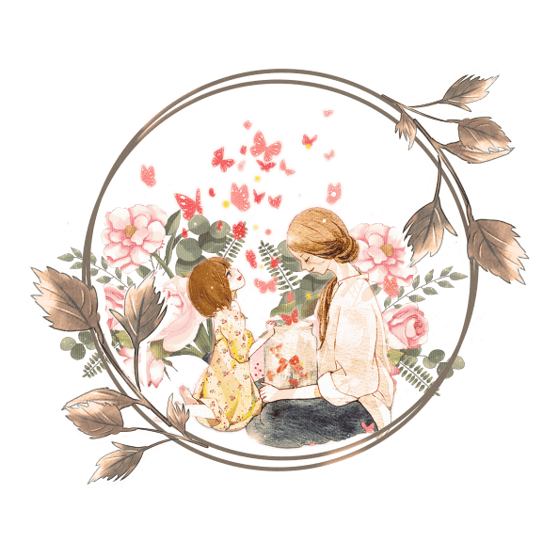
Mother‘s Day blessing
母亲节祝福
On this day we all sit back and think about how much our mothers do for us.
在这一天，我们将会抽空休息一下，想想妈妈们帮我们做了多少事。
I've tried many times to tell you, but I'll say it again: I love you mother.
我已经告诉您许多次了，但是我将再说一次：我爱您，妈妈。
Though it is hard to tell you sometimes, I do love you dearly, mom.
虽然有时要告诉您并不太容易，但是我真的非常爱您，妈妈。
I may not often say it, but I do love you.
我也许并不常挂在嘴上，但我真正爱您。

Slide 17
Mother‘s Day blessing
母亲节祝福
I don't take the time to tell you this often, but I love you, mom.
虽然我经常没有时间告诉您，但我真的爱您，妈妈。
To mother on Mother's Day: Thank you for all of the wonderful things that you h ave done for me.
母亲节给妈妈：谢谢您为我做了那么多奇妙的事。
There are little things that I should have said and done to show my gratitude, but it is appreciated what you do.
尽管我为表示谢意所说的和所做的都那么少，但同样也是表达对您所做一切的感激之情。
Sometimes I cry and make you sigh, but you know that I love you so.
有时候我哭泣而使您叹息，但您却知道，我是如此地爱您。

Slide 18
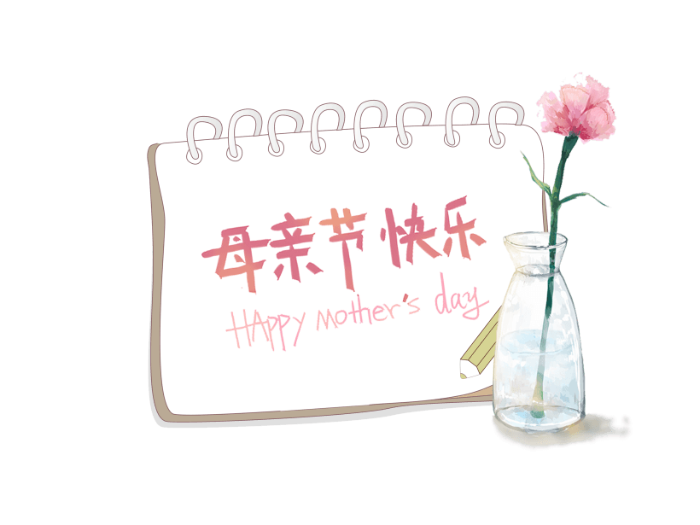
Mother‘s Day blessing
母亲节祝福
This card is from all of us. It may not be the greatest, but it's from the heart.
这张卡片是我们合送的。它也许不是最棒的，但却是出自内心的。
Mother, I just want to let you know that you are always in my thoughts.
妈妈，我只是想让您知道，您一直都在我的心中。
We may not be angels all of the time, but we do appreciate what you do.
我们也许不是一直都像天使那样乖巧，但我们确实感谢您的教诲。
Thanks for being there, mom. Happy Mother's Day.
谢谢您不断地扶持我。祝您母亲节快乐。

Slide 19
5.10
感谢您的观看！
蓝色温暖母亲节通用PPT模板

Slide 20
更多精品PPT资源尽在—优品PPT！
www.ypppt.com
PPT模板下载：www.ypppt.com/moban/ 节日PPT模板：www.ypppt.com/jieri/
PPT背景图片：www.ypppt.com/beijing/ PPT图表下载：www.ypppt.com/tubiao/
PPT素材下载： www.ypppt.com/sucai/ PPT教程下载：www.ypppt.com/jiaocheng/
字体下载：www.ypppt.com/ziti/ 绘本故事PPT：www.ypppt.com/gushi/
PPT课件：www.ypppt.com/kejian/
Notes:
模板来自于 优品PPT https://www.ypppt.com/

